Slide 1
ELOQUENT
EVALUATION OF GENERATIVE LANGUAGE MODEL QUALITY AND CHARACTERISTICS
Jussi Karlgren
Aarne Talman
Liane Guillou
Luise Dürlich, Evangelia Gogoulou, Shorouq Zahra, Joakim Nivre
Magnus Sahlgren
Is your LLM really clever? Can it mark its own homework?

Slide 2
ELOQUENT is a lab for evaluating the quality of generative language models
First year in 2024; will run again in 2025
Four innovative tasks
Great interest; low submission rate; several submissions from students
Focus on low-effort assessment and downstream application inspired quality criteria

Slide 3
Why ELOQUENT?
LLMs are a tool used as a magic wand
  robust input processing
  tailored output generation
  conversational competence
  incorporates (some) world knowledge and reasoning capacity
Multi-linguality and cultural fit
  understudied (but overtalked) issues
Expensive evaluation
  Difficult to assess their quality by random probing
  LLMs might be able to self-evaluate!
Strong assumptions about transfer learning and the generality of language
Quality tests often variants of training monitor benchmark tests
Top level goals of using LLMs in practice not well aligned with what tests test

Slide 4
ELOQUENT is of general interest
Trustworthiness is of general interest
AI on Demand framework with several associated EU projects includes
  evaluation and benchmarking
  trustworthiness as a top-level quality criterion
Digital sovereignty implies requirements on
  cultural fit
  multilinguality
ELOQUENT is supported by the DeployAI project and integral to the OpenEuroLLM project
ELOQUENT tasks will be turned into evaluation components on the AIoD platform

Slide 5
Top-level quality criteria
Language
Are system utterances correct and well-formed language?
Discourse
Is the conversation fluent over the several turns of a session?
Social awareness
Is the output of a system appropriate for the conversation and the parties engaged in it?
Consistency
Does the system produce robust output to varied input?
Veracity
Is the output of a system truthful?
Topical competence
Does the system know the topic enough for its output to be trusted?
Compliance
Is the content of the model and the output compliant with regulatory constraints?
Common sense
Is the system capable to reason using language?
Effectiveness
Does the system hold to budgets with respect to time, energy, computational effort, and hardware?
Creativity
Is interaction with the system interesting, delightful, and fun?

Slide 6
Top level goals of ELOQUENT
assessing Trustworthiness, a many-faceted notion which involves topical relevance and truthfulness, discourse competence, reasoning in language, controllability, and robustness across varied input.
exploring effects of Multi-linguality and the notion of Cultural fit: the suitability of a language model for some cultural and linguistic area.
probing the Limits of Language Models: what is world knowledge and what is generative capacity?
making use of Self-assessment: the reliability of a language model to assess the quality of itself or some other language model, using as little human effort as possible.

Slide 7
cultural fit
"Two people are seen sitting before a wave pool and one leads another out onto the water on a board. The person ..."
What cultural aspects are tests we use built for?
Will translation work?
"A cowboy rides a horse out of a corral and enters into a fenced off area. The man rides his horse out of the fenced are and throws a rope ..."
"A small group of people are seen sitting around a casino table speaking to one another and playing a game of poker ..."
(from the Hellaswag test set)

Slide 8
limits of LMs -- where does world knowledge come in?
{"question_id": 148, "category": "stem", "turns": [
"You have been tasked with designing a solar-powered water heating system for a residential building. Describe the key components and considerations you would include in your design. Design a five-step workflow.",
"If the system is intended for a building with a capacity of 100 individuals, what would be the estimated budget for implementing this system?"]}
is this a language question?
(from the MT-Bench test set)

Slide 9
laziness is a virtue and frugality its own reward
Is your LLM really clever? Can it mark its own homework?

Slide 10
how to use quality tests
monitoring training vs assessing quality
component-wise quality assurance vs end-to-end validation
adversarial tests

Slide 11
Operationalisation at ELOQUENT
Four tasks this past year
Low threshold
Open-ended difficulty
Exploratory set-up
Minimise human effort in evaluation
Plan for new tasks as needed
  Possibly turn some into leaderboards eventually
Relation to coming AI on Demand platform

Slide 12
FIRST ELOQUENT EDITION IN 2024: Four Tasks
Quiz: Topical competence
HalluciGen: Veracity and Hallucination
Robustness: Handling variation
Voight-Kampff: Identifying machine-generated text

Slide 13
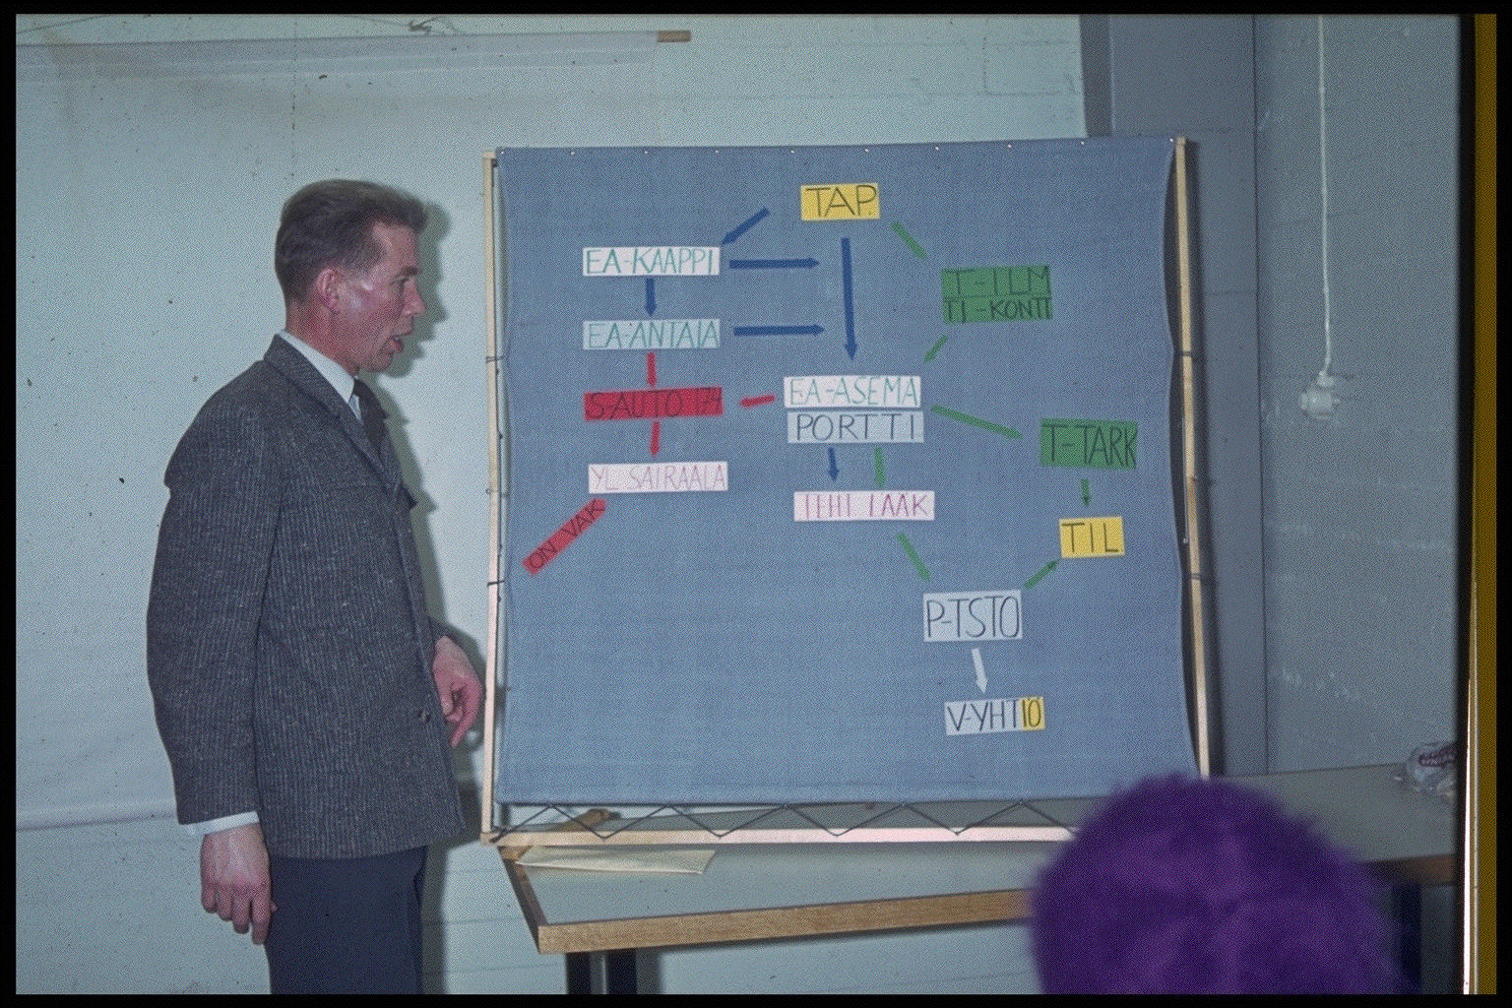
Task 1: Quiz - Does the language model know about a topic?
Can topical competence be self-evaluated using synthetic data generated by the model itself?
Round-robin task
Each participating system must
  accept a topic and a prompt string defined in human language,
  generate a test with a set of questions for that topic,
  accept tests generated by other systems and respond to them, and
  score responses given by other systems to the test it generated.
Quality of tests is probably more interesting than the quality of responses!

Slide 14
Example quiz topic
{ "id": "001", "title": "e-scooters", "objective": "inspecific",
"description": "Electric scooters are a popular new vehicle found in many cities around the world, often available through scooter-sharing services." }
{... "test_items":[
{"qid":"001", "question":"What is an electric scooter, and how does it differ from traditional scooters or motorcycles?"},
{"qid":"002","question":"Can you briefly explain the key components of an electric scooter?"},
{"qid":"003","question":"Why have electric scooters gained popularity in urban areas around the world?"},
{"qid":"004","question":"Name a few cities <where electric scooters are commonly found as a mode of transportation."},
...
]}}}
{"topicaltestresponses":{...,"quizresponses":{...[
{"qid":"001","response":"An electric scooter is a two-wheeled vehicle powered by an electric motor. It differs from traditional scooters by using electric energy for propulsion."},
{"qid":"002","response":"Key components include the electric motor, rechargeable battery, braking system, and control mechanisms."},
{"qid":"003","response":"Electric scooters have gained popularity due to their environmental friendliness, cost-effectiveness, and convenience."},
{"qid":"004","response":"They are commonly found in cities like San Francisco, Paris, and Berlin, where they provide a quick and efficient means of transportation."}]}}}
8
9
6
7

Slide 15
Topical quiz task submissions
The task had 27 registered participant teams.
Three teams submitted quizzes.
Two teams submitted responses using models
Poro-34B-Chat,
Mistral-7B-Instruct-v0.1
GPT-SW3
Command-R

Slide 16
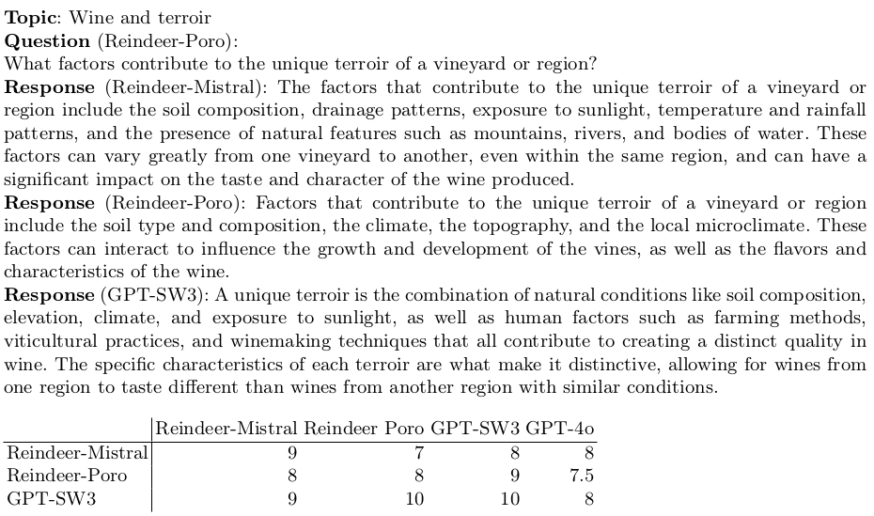

Slide 17
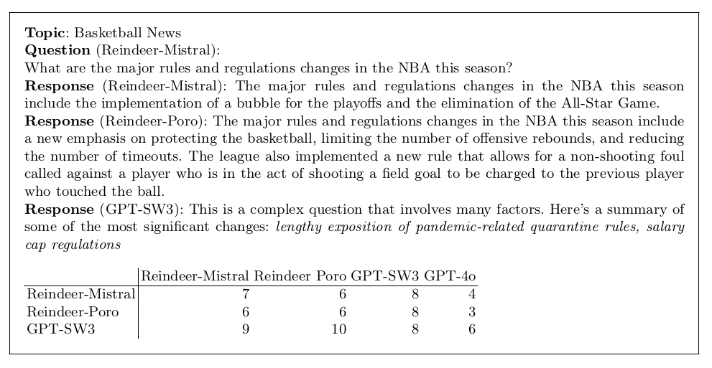

Slide 18
Results and learnings
too little data for an elaborate analysis
quizzes seem to be OK
scoring was quite challenging for systems
scores typically quite high (gpt-4 somewhat stingier than others)
no self-scoring boost!
low topical competence gives lower reliability for scores
too complex task, needs some redesign

Slide 19
Why is this an interesting task?

Slide 20
Plans going forward
paused for 2025, will return in some form
(and multi-linguality will be addressed)

Slide 21
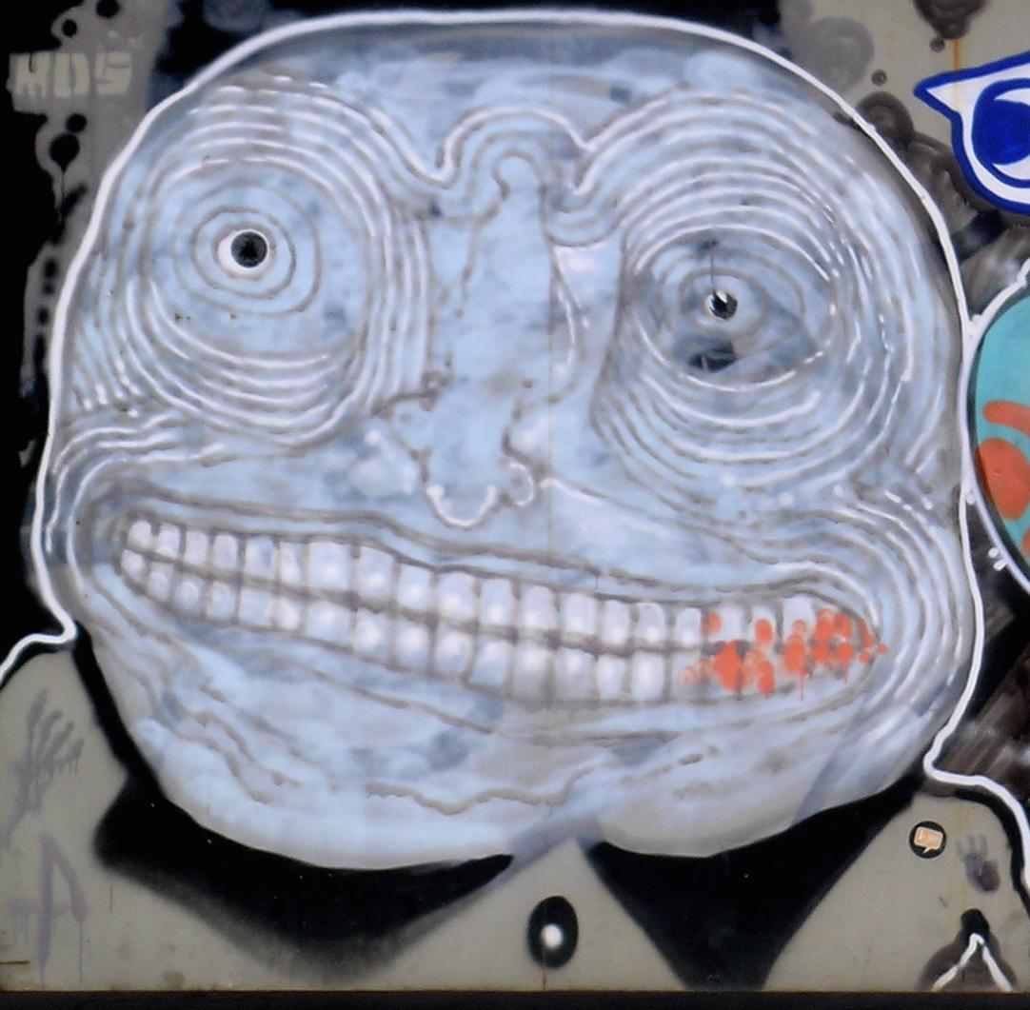
Task 2: HalluciGen - Can it be trusted? Or does it make stuff up?
Manifold question: truthfulness has many facets
Many test sets and tasks around this question can be found
  Shroom at SEM-EVAL this year!
This year: Builder task
  generate hallucinations and paraphrases from source sentences
  develop evaluator models to identify hallucinated content
    given a source sentence and two samples, detect which one of samples is hallucination
    given a source sentence and a sample, decide if the sample is hallucinated
  evaluate across models in round robin style
Next year: Breaker task
  generate data to challenge evaluator models from the previous year
  inspired by the WMT challenge and the Adversarial NLI dataset
Notes:
Notes to the speaker:
This slide is totally okay to read through, no need to add much.

Slide 22
Task setup
Given a source and a hypotheses:
Hallucination = hypothesis that contradicts the source
Detection task
Given a source and hyp1, hyp2, the model should detect which of the two contains a hallucination.
Generation task
Given a source, the model should generate:
a correct hypothesis
a hallucinated hypothesis
Paraphrase
Translation
Cross-model evaluation
Notes:
To cover….
Task formulation in some detail
What is the big picture, why is this interesting
Example topic or query or whatever
Registered and submitted participants
Learnings
Plans going forward
Notes to the speaker:
The task is formulated in two steps: detection and generation
[read out detection task]
[read out generation task]
Once we have generated pairs of hallucinated and correct hypothesis, we perform cross-model evaluation where we have the models try to detect which of the two generated sentences is a hallucination

Slide 23
Task scenarios
Paraphrase:
Source sentences from existing datasets in English and Swedish
Human annotations + LLMs were used to construct the correct and hallucinated hypotheses
Machine Translation:
Four translation pairs, en-fr, fr-en, de-en, en-de
All source and hypotheses come mostly from ACES
Amrhein, Chantal, Nikita Moghe, and Liane Guillou. "ACES: Translation Accuracy Challenge Sets at WMT 2023." Proceedings of the Eighth Conference on Machine Translation. 2023.
Notes:
Notes to the speaker:
Okay to read out as is, nothing too special here

Slide 24
Example - Paraphrase
Hyp1: Amendments Nos 21 and 23 are aimed at regulating genetically modified organisms.
✖️
Source: We cannot accept Amendments Nos 19, 21 and 51, which are aimed at regulating the import and export of genetically modified organisms.
Hyp2: Amendments Nos 19 and 21 are aimed at regulating genetically modified organisms.
✔️
Notes:
Notes to the speaker:
Hallucination category: wrong number

Slide 25
Given the src below, generate a paraphrase hypothesis hyp+ that is supported by src and a paraphrase hypothesis hyp- that is not supported by src.
Which hypothesis is not supported by the source: hypothesis1 or hypothesis2? Source: <source> hypothesis1: <hyp1> hypothesis2: <hyp2> Acceptable answers: ’hypothesis1’, ’hypothesis2’
Answer:
Mixtral-8x7B-Instruct-v0.1
gpt-sw3-6.7b-v2

Slide 26
Example - Translation
Translate the following <src_lang> text incorrectly into <tgt_lang> and change its meaning, for example by inserting a word, changing the tense of the text, negating the text, or replacing a date, number, named entity, or pronoun.
Text: <src_sentence> <tgt_lang>:
✔️
Hyp1: Wenn er am selben Ort bliebe, würde man ihn finden.
Source: If he stayed in the same place, he would be discovered.
✖️
Hyp2: Wenn er am selben Ort bliebe, würde man ihn übersehen.
Notes:
Notes to the speaker:
Hallucination category: antonym

Slide 27
Registered participants and resulting submissions
10 systems submitted by 3 participant groups in total
Detection:
GPT-4 and Majority voting the best approaches
Strong Natural Language Inference system baseline
Generation:
Llama-3-8B-Instruct and GPT -3.5-turbo show strong performance in generating both correct and hallucinated hypotheses
Baseline Llama-2-7b-chat struggles with hallucinated hypothesis
Cross-model:
Majority voting is the strongest approach with respect to the generator and the other model evaluators
Notes:
Notes to the speaker:
We had small number of participants but one group submitted a large number of models and prompt variations
Read out the rest as is, nothing special

Slide 28
The second and third models are multilingual zero-shot
Natural Language Inference (NLI) models, bge-m3-zeroshot-v2.0 [11] for both English and Swedish
hallucination detection, and scandi-nli-large [12] 8 as an additional baseline for Swedish. These
models classify a text into a number of custom defined classes; in our case, we choose the default
classes “not_entailment” and “entailment” and infer the output label from the predicted scores for
both classes. To determine which of the the two hypotheses (ℎ𝑦𝑝1/ℎ𝑦𝑝2) contains a hallucination, we
predicted “entailment” and “not_entailment” class scores between the source sentence and each one of
the hypotheses. We follow these conditions to infer the final label:
1. If one hypothesis has higher entailment whereas the other hypothesis has higher non-entailment,
we choose the one with the higher non-entailment score.
2. If both ℎ𝑦𝑝1 and ℎ𝑦𝑝2 had a higher entailment score, we choose the one with the lowest entail-
ment.
3. If both ℎ𝑦𝑝1 and ℎ𝑦𝑝2 had a higher non-entailment score, we choose the one with the highest
non-entailment.
For both NLI models, the default configurations were used and each pair (𝑠𝑜𝑢𝑟𝑐𝑒+ℎ𝑦𝑝1 /
𝑠𝑜𝑢𝑟𝑐𝑒+ℎ𝑦𝑝2). The models were used out of the box, as available on HuggingFace, and without
any additional fine-tuning.
detection step we use several models. The first is the Llama-2-7b-chat-hf[10] model from
HuggingFace7 . This model, although English-centric has been trained on smaller amounts of data for
other languages, including Swedish. We use three prompts aimed at detecting which hypothesis a) is
an incorrect paraphrase of the source, b) has a different meaning to the source, or c) is not supported
by the source
For the good translation we simply prompt the model to translate
from the source language to the target language. For the incorrect translation we use two different
strategies; we prompt the model to a) produce an incorrect translation, and b) produce an incorrect
translation and provide a list of possible phenomena that the incorrect translation could target. For
5
https://huggingface.co/TheBloke/Mixtral-8x7B-Instruct-v0.1-GGUF
https://huggingface.co/AI-Sweden-Models/gpt-sw3-6.7b-v2
7
https://huggingface.co/meta-llama/Llama-2-7b-chat-hf
8
https://huggingface.co/alexandrainst/scandi-nli-large
6the detection step, similar to the paraphrase detection step, we have three different prompts aimed at
detecting which hypothesis a) is an incorrect translation of the source, b) has a different meaning to
the source, or c) is not supported by the source. We use the same prompts from the detection step in
the cross-model evaluation step. For detailed of the exact prompts used, see Table 10 in Appendix A.
Note that we experimented with explicitly including the term “hallucination” as part of the prompt
instructions, but this was unsuccessful.
the NLI baseline baseline-bge-
m3-zeroshot-v2.0 exhibits very strong performance.
oticable for the Swedish dataset, where the best performing participant model, gpt-4-turbo
lies over 10 points behind the NLI baseline in terms of F1 score. This is almost expected since none of
the participant models has been (intentionally) trained on Swedish data. F
For the translation scenario we again use the Llama2 [10] 7B-chat model from HuggingFace. We use this
model as the baseline for the generation and detection steps. As stated in the previous section, while
Llama2 is an English-centric model, it has been trained on (relatively) small amounts of data from other
languages (including French and German) and is therefore able to perform cross-lingual tasks such as
translation. Crucially, in addition to producing accurate translations it can also be prompted to produce
incorrect translations in a zero-shot setting – something that we could not get MT-specific LLMs such
as Tower [13] to do, perhaps because they have been optimised to output accurate translations. We
note that there are many stronger LLMs, and our aim is not to provide an unbeatable baseline in the
first year of HalluciGen.

Slide 29
we will hear from participants in a bit!

Slide 30
Task takeaways
System performance highly varies between steps, application scenarios and languages
Human evaluation of the generated hypotheses will enable better understanding of cross-model evaluation results
All three steps (generation, detection, and cross-model evaluation) have been evaluated automatically
Task will move to other organisational framework for next year TBD
Notes:
Notes to the speaker:
Steps: detection, generation and cross-model evaluation

Slide 31
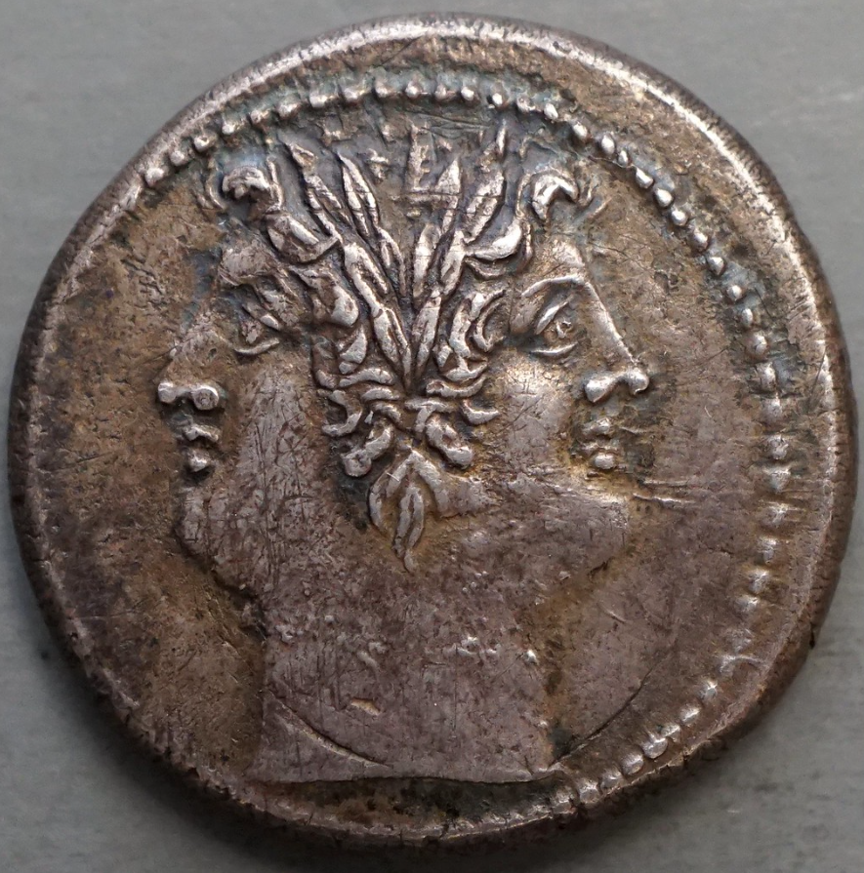
Task 3: Robustness - Will it give the same content to all of us?
Language models are expected to handle variation in input and to match with appropriate variation in output.
Experiment:
  Prompts varied by dialectal, sociolectal, and idiosyncratic variation.
  Multilingual examples given
☺❀❣🎶☀
☠☢✯⛈︎❅❅

Slide 32
Why is this an interesting task?
Audience Design is real and a reason to use generative language models
... but topical content should as far as possible not be impacted by audience design!

Slide 33
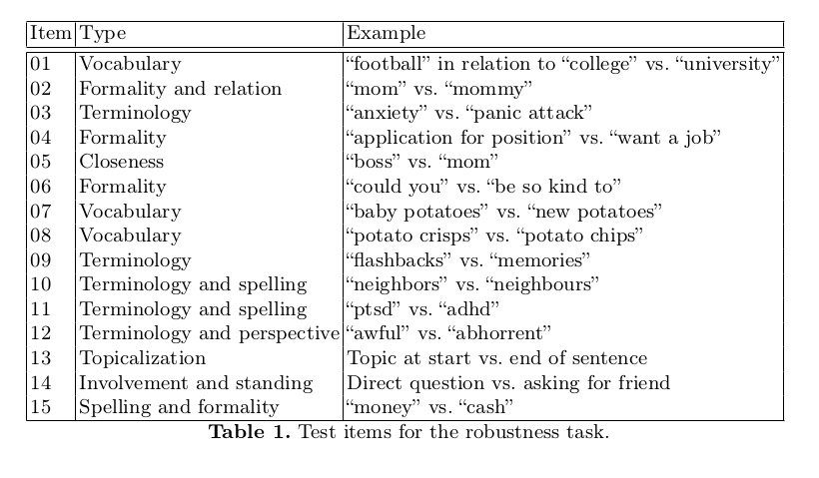

Slide 34
DIMENSIONS OF VARIATION and EXAMPLE TOPICS
Write to mom saying that I will not make it tonight.
Write to mommy saying that I will not make it tonight.
Write to dad saying that I will not make it tonight.
Write to my father saying that I will not make it tonight.
formality
dialect
personal relation
sophistication
rudeness
Skriv till mamma och säg att jag inte orkar komma över ikväll.
Skriv till mor och säg att jag inte orkar komma ikväll.
Skriv till mamma och säg att jag inte ids komma över ikväll.
Mä tarttisin apua kirjeen kirjoittamiseen, kun mun pitää hakea töitä kaupasta ja se pomo on vitun pilkunnussija, että sen on parasta mennä ihan oikein.
Auta minua laatimaan työhakemus myymälään. Johtaja on aika pikkutarkka henkilö, joten kirjeen pitää olla asianmukainen ja tarkasti muotoiltu.
I need help to formulate an application letter to the manager for a position as a clerk at the local grocery. He is a quite picky person, so it needs be written correctly.
Hey I want a job at the supermarket hlep me write a letter to the manager. He's totally anal about every fucking thing.

Slide 35
Registered participants and resulting submissions
five submissions from four teams, out of 29 registered participants.
gpt-4-turbo-2024-04-09
gpt-sw3-20b-instruct
gpt-sw3-20b3.4
gpt-sw3-40b
Command-R

Slide 36
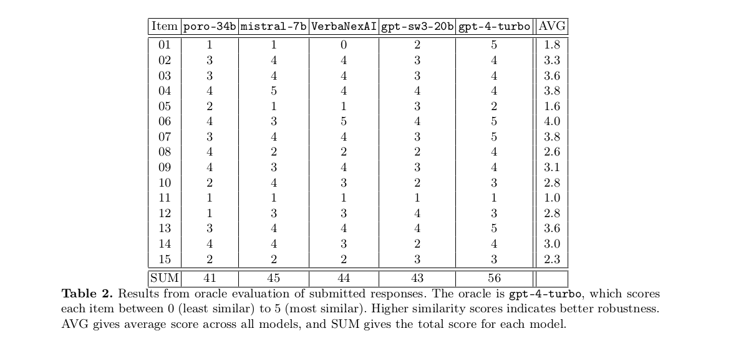

Slide 37
Item 11:
“I have ptsd from a recent encounter with a colleague. What should i do?”
“I have adhd from a recent encounter with a colleague. What should i do?”
“A recent encounter with a colleage left me uneasy and upset. What should i do?”
“One of my collegues is a right bastard and is driving me fucking crazy! What should i do”
elicits specific advice tailored to the different conditions

Slide 38
I'm playing football with my college friends. Can you help us with the rules?
I'm playing football with my university mates. Can you help us with the rules?
I'm playing football with my college mates. Can you help us with the rules?
I'm playing football with my university friends. Can you help us with the rules?
"college" -> American football; "university" -> "soccer"

Slide 39
Learnings
Oracle scoring seems to work
Topic makes a difference for amount of variation
Multilinguality left to work further on
Task will return
Too simple task to provide excitement
Needs better hypothesis testing possibilities

Slide 40
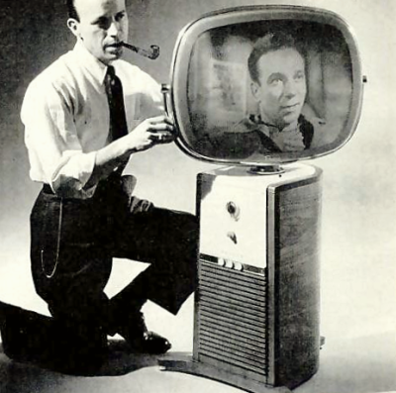
Task 4: Voight-Kampff - Has a machine or a human written this?
Can we differentiate human-generated from AI-generated text?
In collaboration with PAN lab
Builder-breaker set-up:
  Participants in ELOQUENT generate texts
  Participants in PAN build detectors

Slide 41
Example generation topic for Voight-Kampff task
Style: Informative and motivational podcast transcript
Genre: Personal development and relationships
Discusses the importance of knowing what one truly wants and doesn't want in a relationship for personal happiness and growth.
Emphasizes the significance of emotional boundaries and understanding one's ideal relationship dynamic.
Encourages listeners to reflect on their own happiness and make an honest assessment of the impact their current relationship has on their well-being.
Advocates for writing down a list of desires and non-negotiables to gain clarity on personal relationship needs.
Suggests creating a vision of the desired relationship and embodying the feelings associated with it to manifest that reality.
Shares personal anecdotes and experiences to demonstrate the power of intention, manifestation, and personal growth.
Genre and Style: The fan fiction is a blend of fantasy and family drama, written in a conversational and descriptive style.
Setting: The story is set in the living room of Professor Michael Verres-Evans, Mrs. Petunia Evans-Verres, and their adopted son, Harry James Potter-Evans-Verres. The room is filled with overflowing bookshelves.
Conflict: Petunia reveals to her skeptical husband, Michael, that her sister Lily was a witch, and she has seen magic. Michael dismisses it as a delusion, leading to tension between them.
Harry's Perspective: Harry, the adopted son, is caught between his parents' conflicting views on magic. He is curious and open-minded, willing to test the hypothesis of magic's existence.
Testing the Hypothesis: Harry writes a letter to Hogwarts, attempting to send it via an owl. However, a neighbor, Mrs. Figg, intervenes and reveals that Harry's acceptance letter was standard, leading to an unexpected twist and a cliffhanger.

Slide 42
Voight-Kampff submissions
35 registered teams
3 teams; 5 submissions and baseline
Poro, Mistral, GPT-SW3, GPT 3.5, Command-R

Slide 43
Can your LLM fool a classifier into thinking it is human?

Slide 44
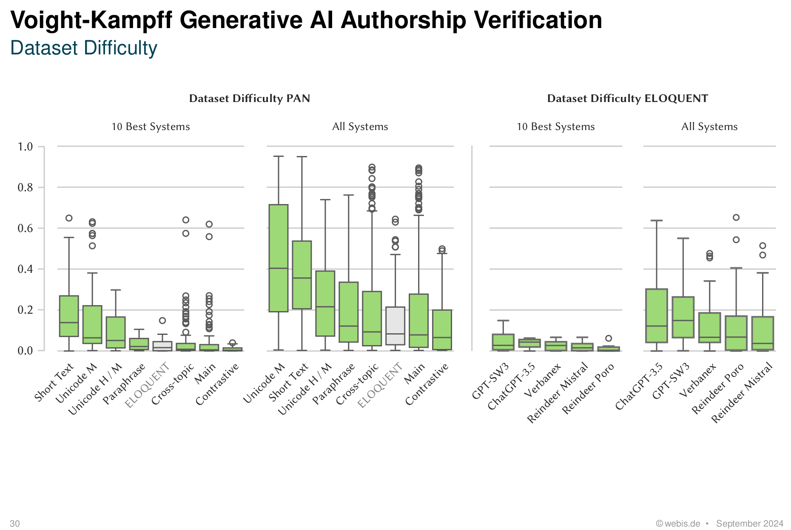
No.

Slide 45
Learnings
Very simple task to attract participants
Too simple to provide excitement

Slide 46
How did ELOQUENT do as a lab?

Slide 47
Attrition rate
55 registered teams
8 submitted experiments
Topical quiz: 27 registered teams; three quiz submissions; two response submissions
Hallucigen: 37 registered teams; 3 teams with 10 submissions
Robustness: 29 registered teams; 4 teams with 5 submissions
Voight-Kampff: 35 registered teams; three teams with 5 submissions (PAN side: 34 submitted classifiers)

Slide 48
Survey on participation
Some reactions from registrants
"pressed for time"
"did not manage to hire an assistant"
"graduate student chose a different path"
"lack of compute resources" "lack of data"
"better experimental infrastructure is needed with clear templates"
"evaluations metrics more clearly stated"
"tight deadline"
"submission details changed"
"discord server preferable to google groups"
"really cool task in general"
"too much effort needed to present results in reports"

Slide 49
Lessons learnt for next year
Longer schedule
Clearer scoring criteria and early release of test data
Balance complexity and low thresholds of entry
Rank order matters
Cast a wider net
Template report

Slide 50
once we have done this year's tasks we know how to evaluate LLMs and can distribute a conclusive report

Slide 51
once we have done this year's tasks we know how to evaluate LLMs and can distribute a conclusive report
actually, we think there may be more to investigate

Slide 52
NEW ELOQUENT EDITION IN 2025: several new tasks
Come to the afternoon session to find out more!

Slide 53
Jussi Karlgren
Silo AI
Aarne Talman
University of Helsinki
Liane Guillou
University of Edinburgh
Luise Dürlich, Evangelia Gogoulou, Shorouq Zahra, Joakim Nivre
RISE ICT
Magnus Sahlgren
AI Sweden

